Slide 1
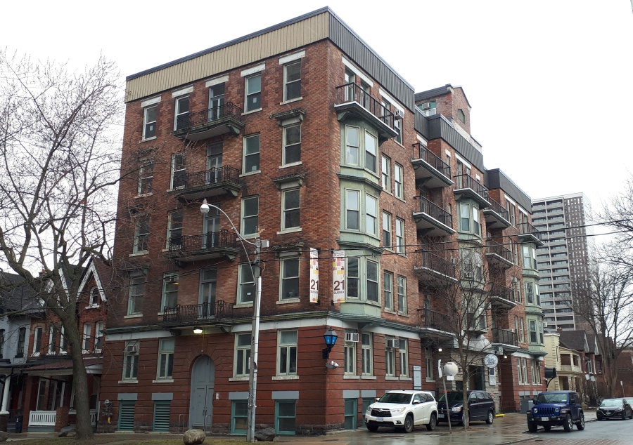

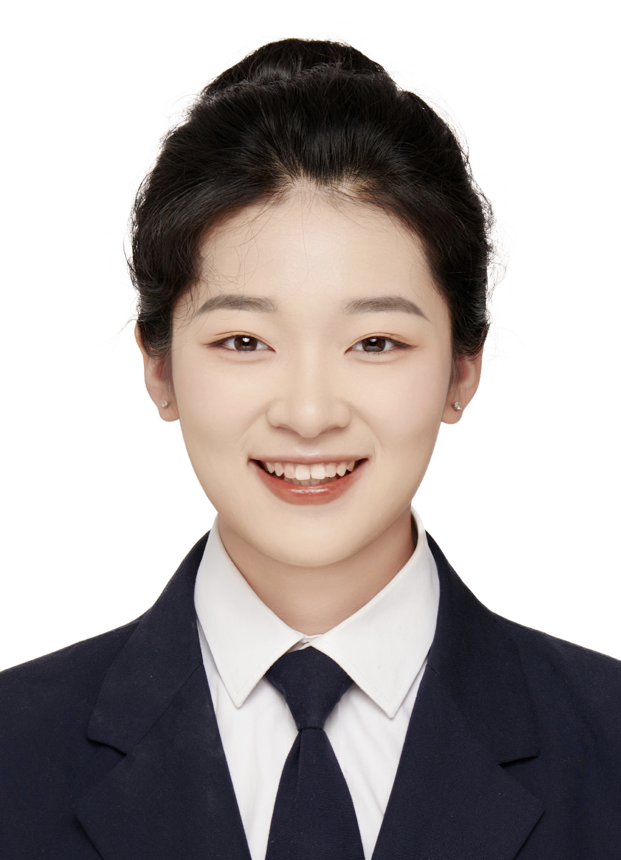
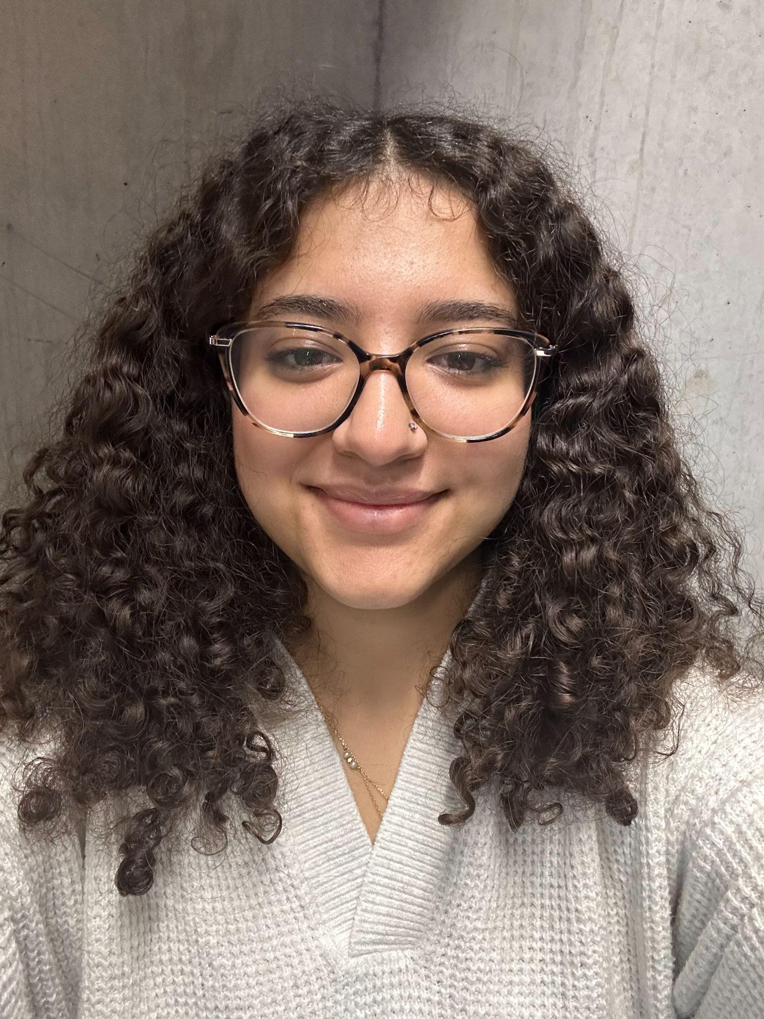
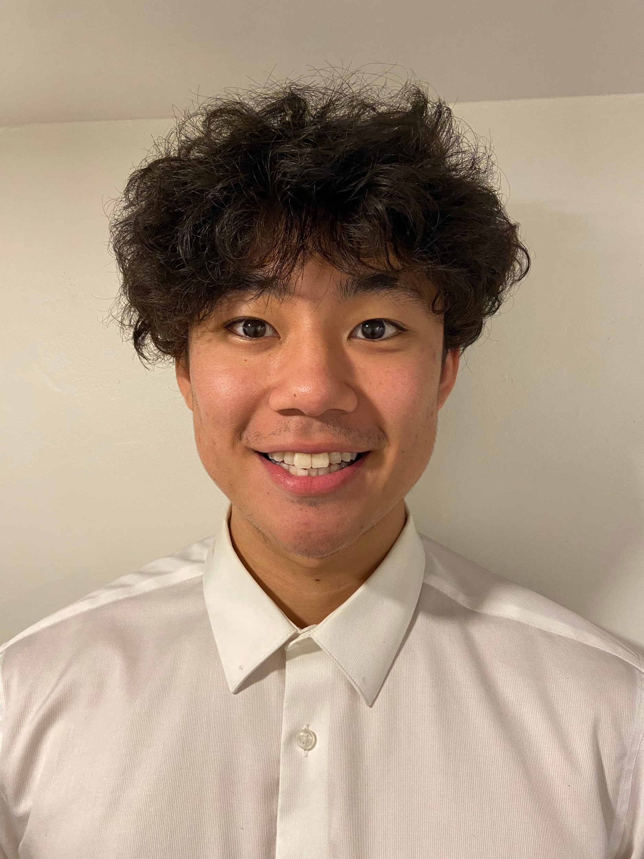
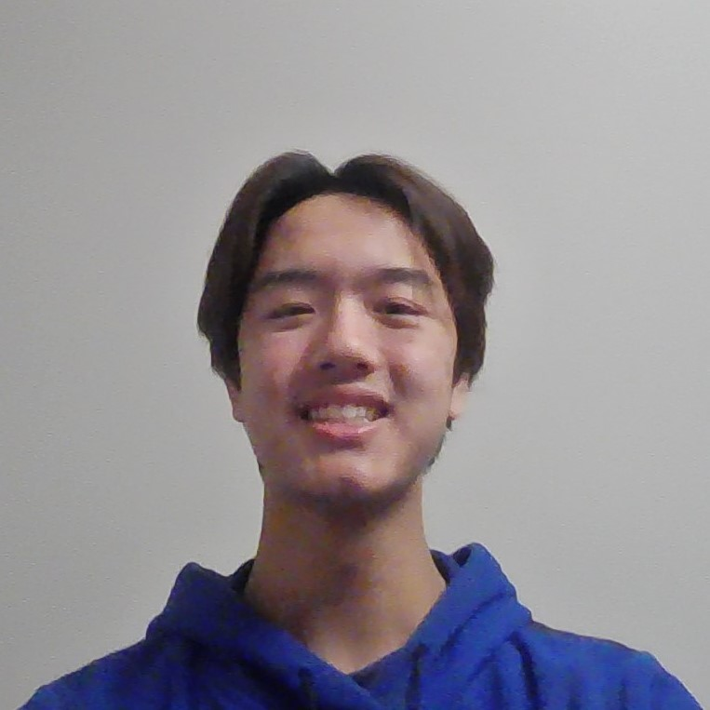

Sussex Clubhouse Space Audit
Client: Alyssa Ahmed
April 16, 2024
Team Leader
Project Manager
Researcher
Secretary
Contact Manager
Editor
Lydia Messiha
Matthew Ting
Anjali Jammulamadaka
Margaret Chen
Chris Yip
Dora Lyu
Notes:
Good morning CI, EM and Alyssa. My name is Lydia Messiha and I am the Team Leader of Team 095 and our project is the Sussex Clubhouse Space Audit

Slide 2
Disclaimer
Lydia Messiha
This design has been prepared by first year engineering and architect students at the University of Toronto and does not present a Professional Engineering or Architecture design. A Professional Engineer or Architect has not reviewed this presentation for technical accuracy or adequacy. The recommendations of this design may not be implemented in any way unless reviewed and approved by a licensed Professional Engineer or Architect where such review and approval is required by professional or legal standards, it being understood that it is the responsibility of the recipient of the design to assess whether such a requirement exists.​
The Presentation may not be reproduced, in whole or in part, without this Disclaimer.
© Engineering Strategies and Practice, University of Toronto, 2024
Permission to reproduce material from this presentation may be requested by email to your team’s contact person, with a CC to Engineering Strategies and Practice at esp@engineering.utoronto.ca
Notes:
This design presentation has been prepared by our first year engineering team. Please note that this design will need to be reviewed and approved by professional engineers before implementation.

Slide 3
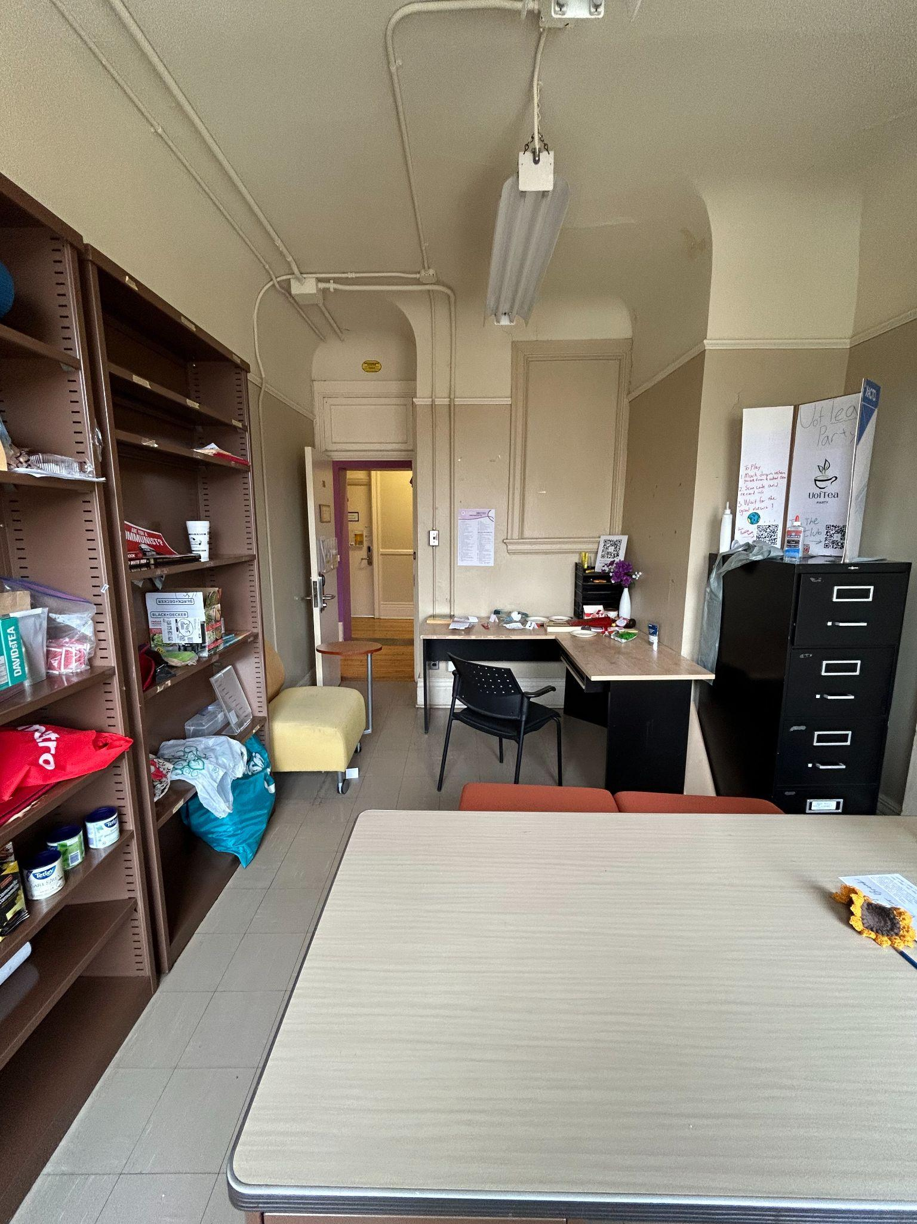
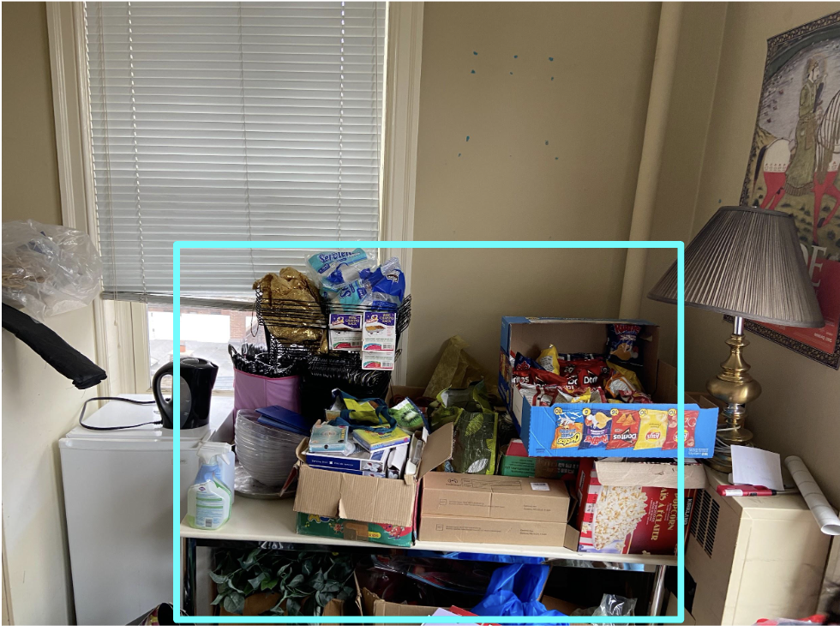
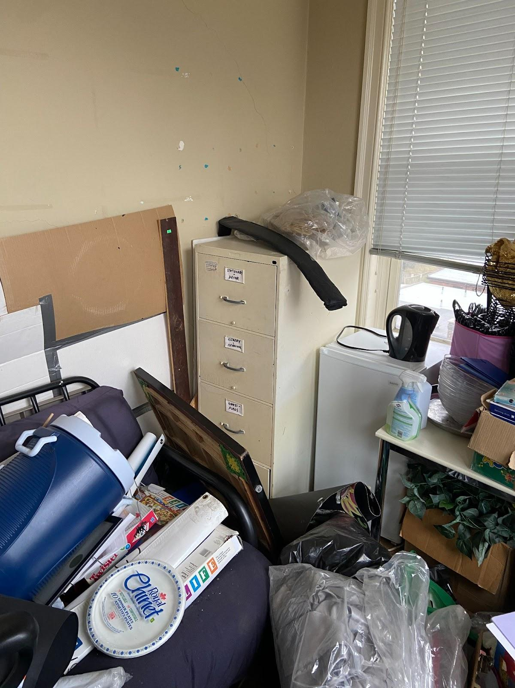
The problem concerning the Sussex Clubhouse revolves around the inadequacy of its layout
Chris Yip
Deficiency in the layout of the space
Our Client desires a lively community environment
The redesign covers the 4th to 6th floors of the Clubhouse building
2
1
3
Notes:
Need to have a bold claim here.

Slide 4
Our team has Identified the
Functions, Objectives, and Constraints
to satisfy the client’s needs
Chris Yip
F
Primary
Meeting and work spaces for clubs and staff
Functions
Functions
Secondary
Create a lively space for collaboration
Provide a proper storage systems for clubs
O
Maximize usage of Space [1][2]
Durable and Robust [1][3]
Universal furniture [1]
Minimize Cost [1]
Flexible and Secure [1][2][4]
Objectives
C
Overtime renovations
Designs initiated by the club.
Maximum capacity of 20 people [5].
Deconstruct room confinements
Constraints
Notes:
Go through functions
Go through objectives and say that these are the main objectives we have defined that have help us come up with our ideas and allowed us to design our alternative ideas and pick our main ideas. Our objectives pertain to both tackling the space problems within the clubhouse as well as the inadequate storage, causing a decrease in the space as well.

Slide 5
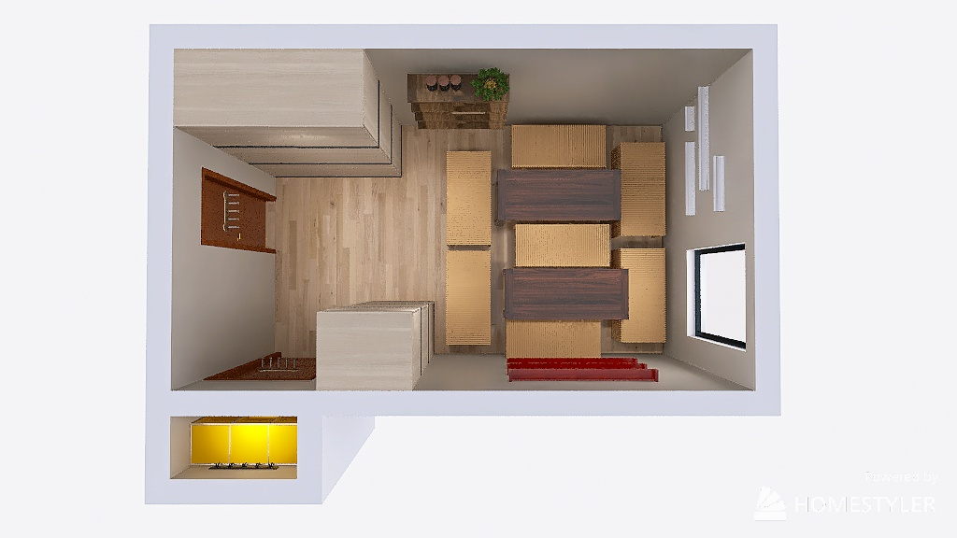
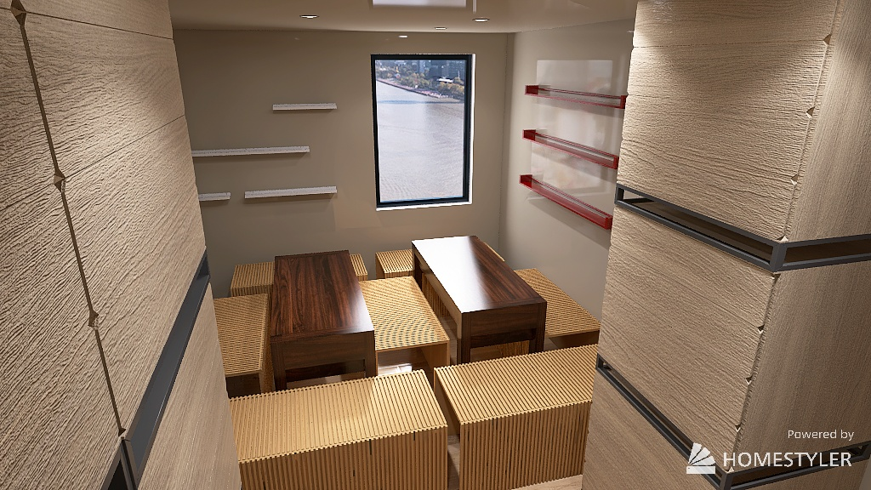
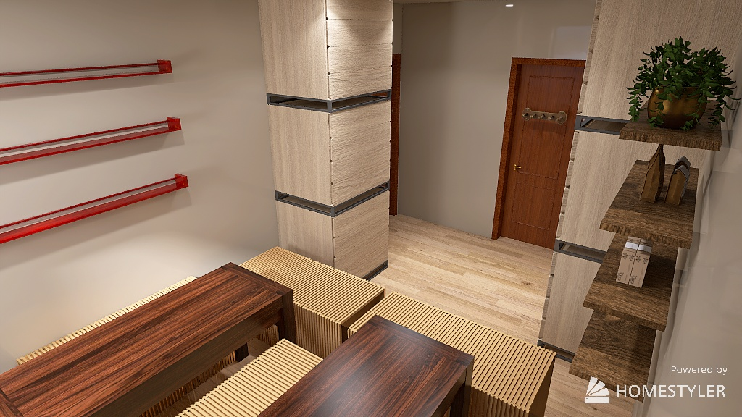
‘Aris’: provides outstanding solutions to all measurable objectives
Matthew Ting
Cabinet/Shelf
Storage
Hooks
Space
Shrinkable Furniture
Hanging Organizer
Price: ($5600-6200) [6][7][8][9]

Slide 6
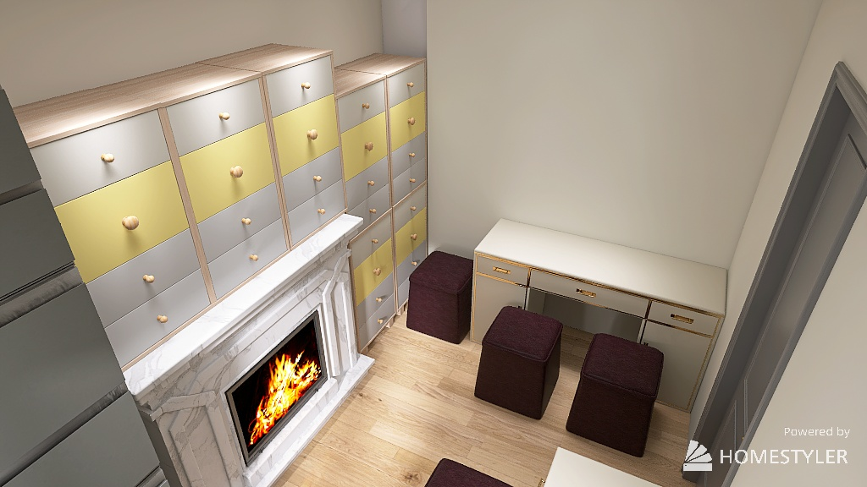
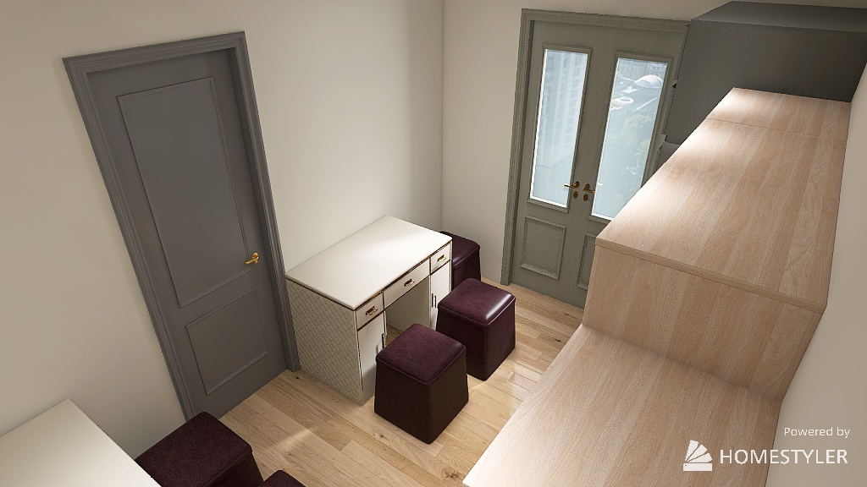
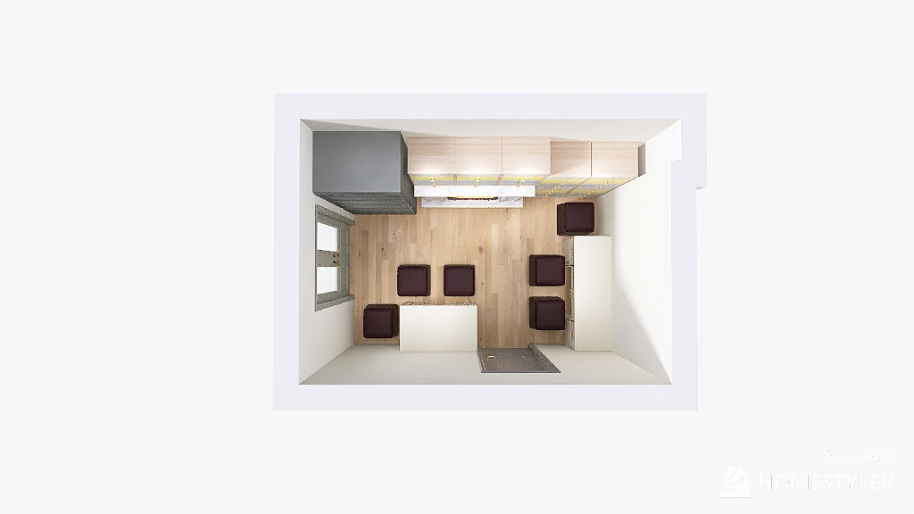
‘Pandora’: provides exceptional use of storage and security
Drawer Dividers
Dora Lyu
Storage
Table with Drawers
Space
None
Ottoman Seats
Price: ($3200-$7000) [7][10][11]
Notes:
Now we come to the two alternative solution, the first one I’m gonna introduce is called Pandora. Our estimated cost is 3200-7000, depending on the size of furnitures need in the room. The top feature of it is the exceptional use of storage and high security. As shown in the visuals we posted here, there we use cabinets and tables with drawer dividers to create separate individual storage, through which increasing the security of storage things a lot. Also with the ottoman seats, as all the storage here are hidden under seats, we can say its safety is reliable as well.

Slide 7
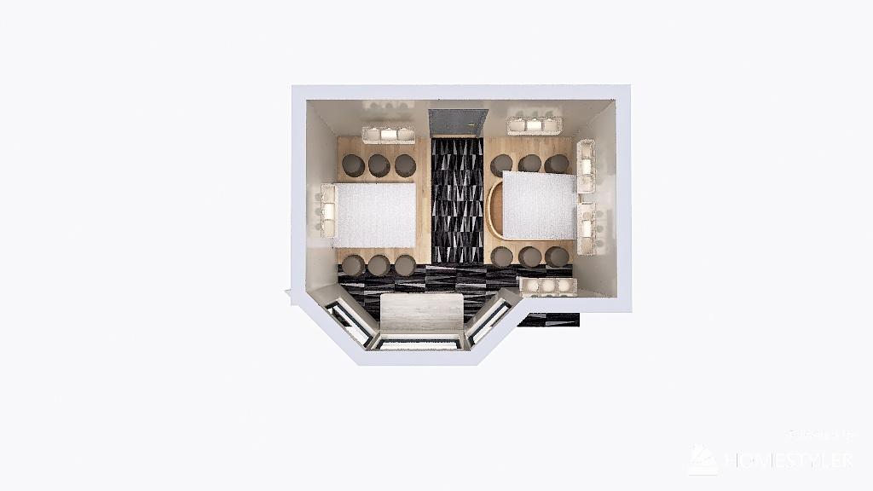
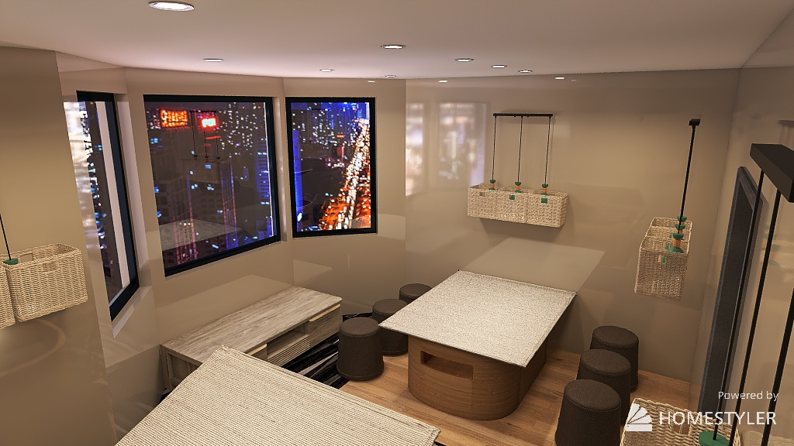
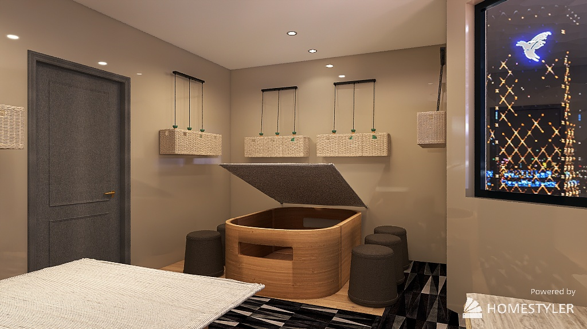
‘Proteus’: highlights the efficiency of storage and minimizes cost
Table with Storage Underneath
Dora Lyu
Storage
Space
None
Ottoman Seats
Price: ($2200) [11][12][13]
Hanging baskets
Notes:
Here we come to the last design, the Proteus. The estimated cost is 2200, which is the best price we’ve ever mentioned. As we can see in the pictures, there we use hanging baskets, ottoman seats as well, and table with storage underneath. Through which we significantly improved the storage ability and minimize cost at the same time. But there’s one thing I have to mention, both of the two I’m presenting, still

Slide 8
‘Aris’ stands out as the ‘most optimal’ solution from its versatility through the measurable objectives
Matthew Ting
 | Max use of space | Adaptable Furniture to (Storage = ST), to (Space = SP) | Minimize cost (Budget of $10,000) | Durable | Secure
‘Aris’ | Room Dependent | Yes (ST,SP) | #2 ($5600-6200) | Measured overtime | Locked
‘Pandora’ | Room Dependent | Yes (ST) | #3 ($3200-$7000) | Measured overtime | Locked
‘Proteus’ | Room Dependent | Yes (ST) | #1 ($2200) | Measured overtime | Not secure

Slide 9
Our team gained user feedback on the current room storage and space efficiency
Active Members
Uoft Economics Club, Room 418
Students' Tea Party (sTEAp), Room 418
Meet and have social gatherings
4+ hours a week
Lydia Messiha
Space Convenience and Comfortability: 4.5/10 average rating
Storage Efficiency: 6/10 average rating
Room Occupants
Additional comments:
Cramped overall feeling
Layout of furniture limits mobility
Notes:
As part of measuring our success the team was able to Survey 2 Uoft Student Clubs that share room 418 in the Sussex Clubhouse
Uoft economics club as well as Uoft Students Tea Party Club. These clubs use this room for 4 or more hours a week and have meetings and social gatherings in this room
Through this survey we were able to gain feedback on how the club felt about their current storage options and space comfortability. Space Convenience was rated an average of 4.5/10 and storage efficiency was rated an average of 6/10.
Through this survey we also found that there were around 27 active members across both clubs, with roughly only half of these members being able to occupy the room and walk comfortably
In addition, the clubs feel cramped and that their mobility is limited
Slide:
Surveyed 2 Uoft Student Clubs occupying room 418 of the Sussex Clubhouse, before implementation of redesign
From survey feedback, we can see these two clubs are unhappy with the current usage of the space and storage options within the club room
Surveyed 2 Clubs using the same room, room 418
Club A: University of Toronto Economics Club
Club B: Students' Tea Party
100% of the clubs use this room to meet and have social gatherings
100% of the clubs utilize this room more than 4 hours a week
rate your convenience and comfortability in holding club activities in your room.
Club A: 6/10
Club B: 3/10
Current storage Space:
Club A: 5/10
Club B: 7/10
Additional comments:
Space is too small for our events. We usually have 30+ people. For club meetings it is fine.
The club office gives people a cramped overall feeling. The layout of the furniture limits our mobility and it's hard to fit more than 4 guests comfortably in the room. The storage space we have in the room is more than enough

Slide 10
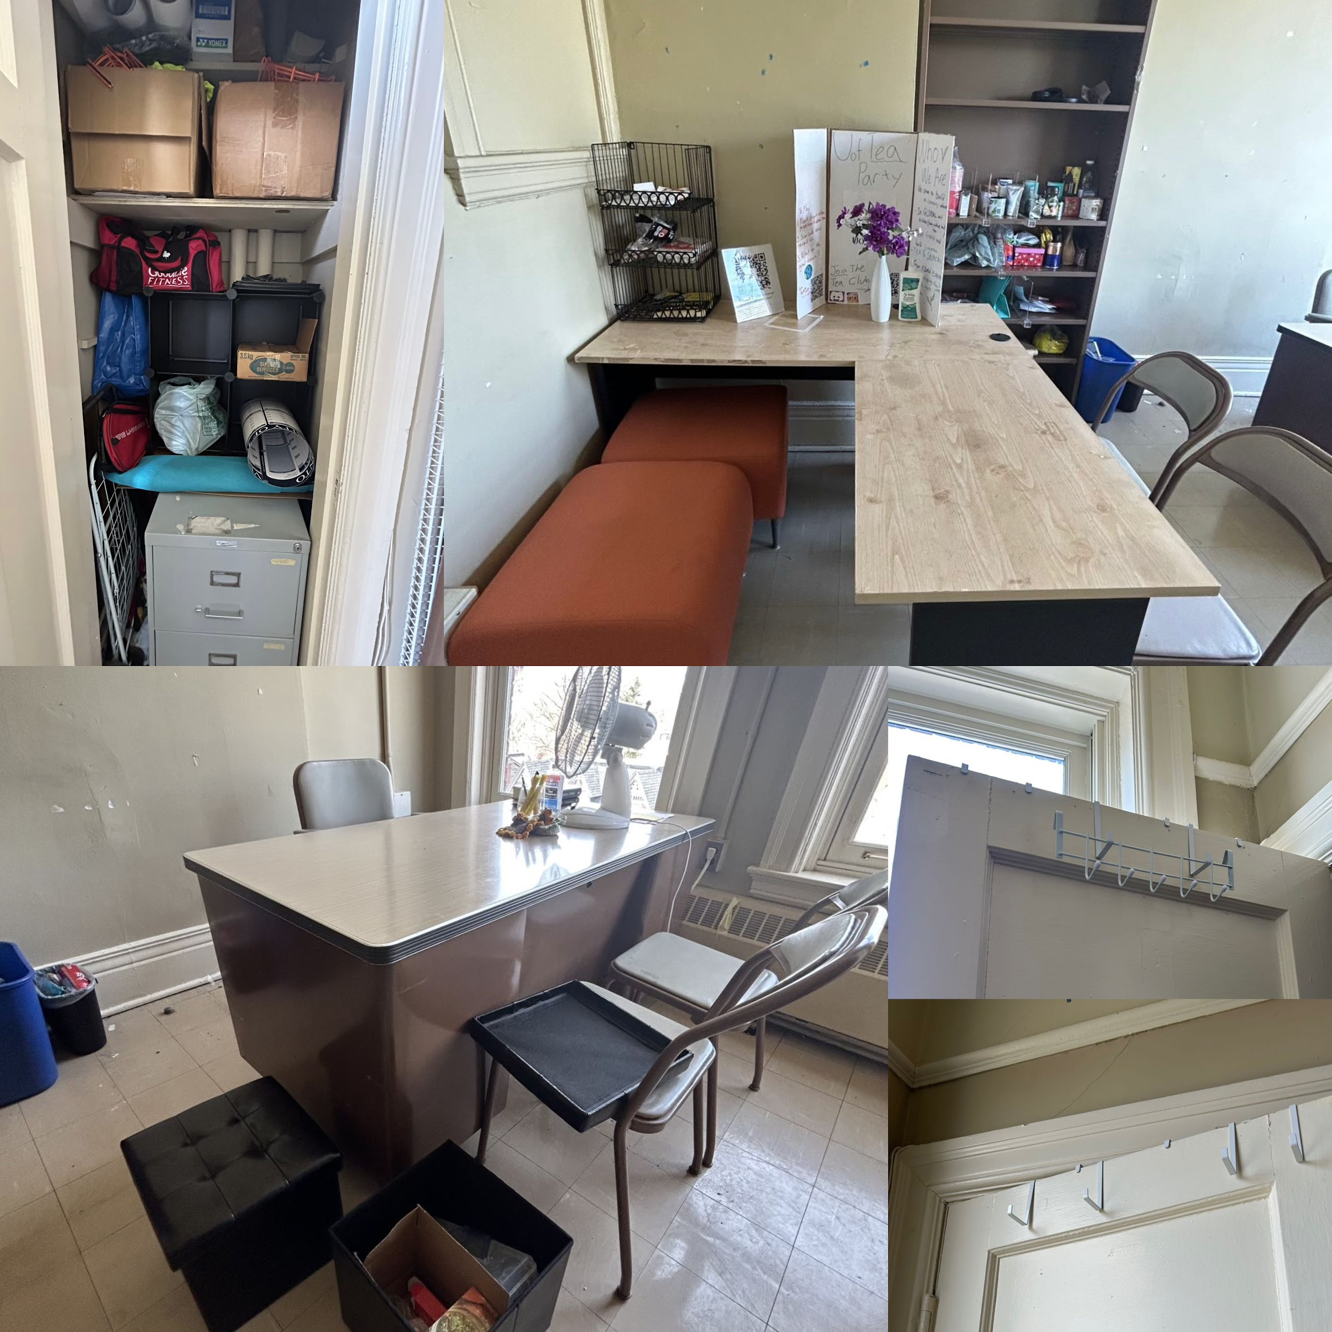
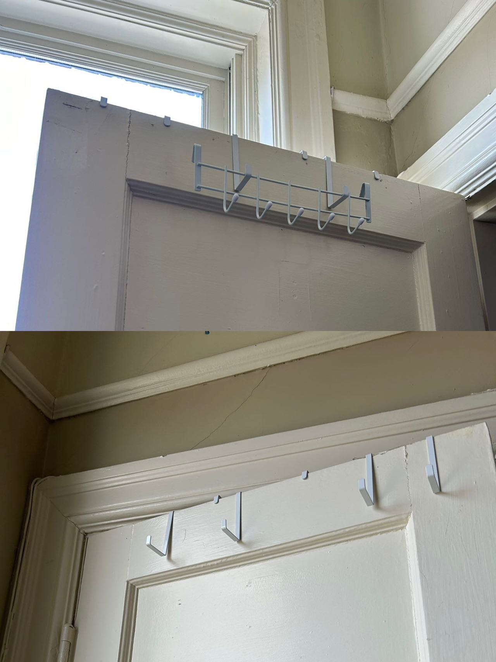
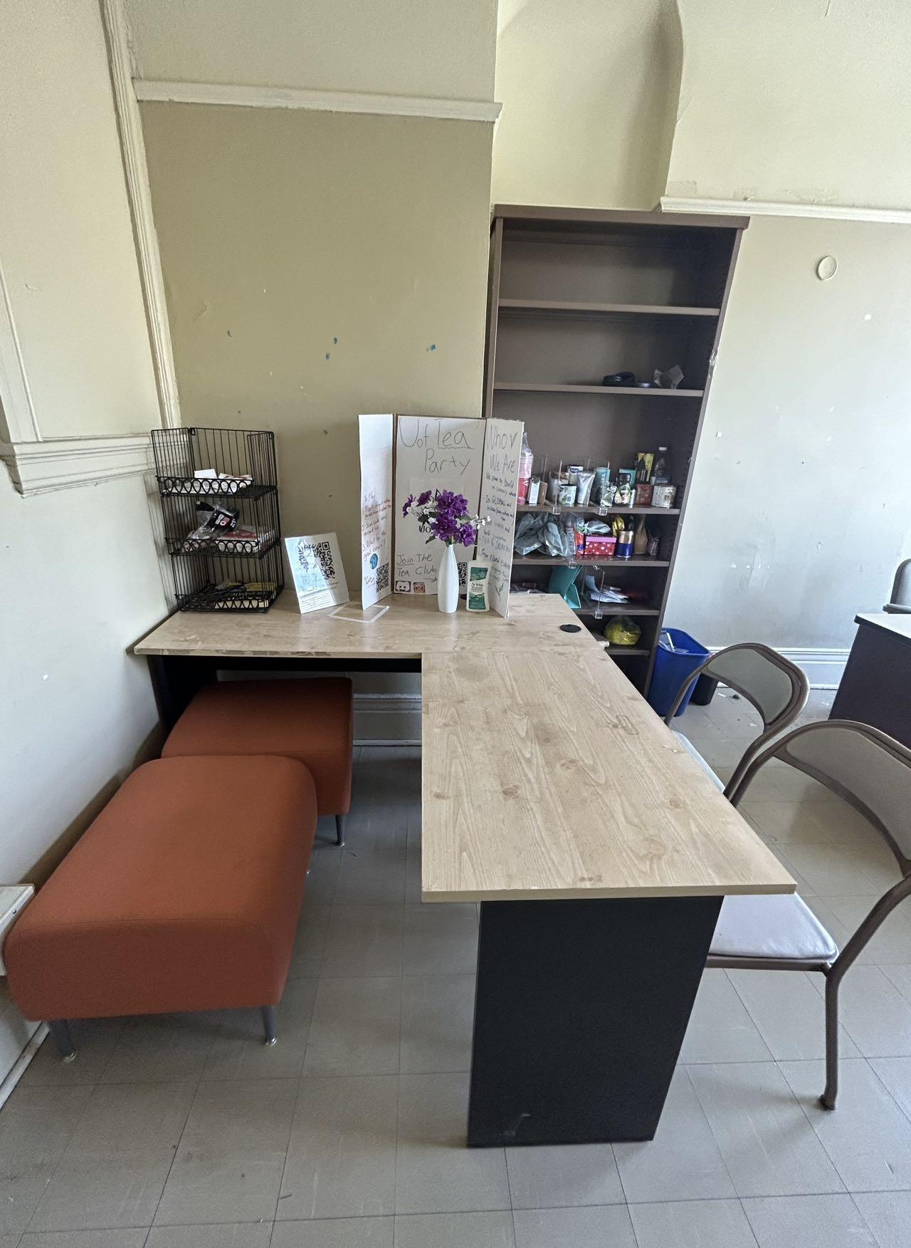
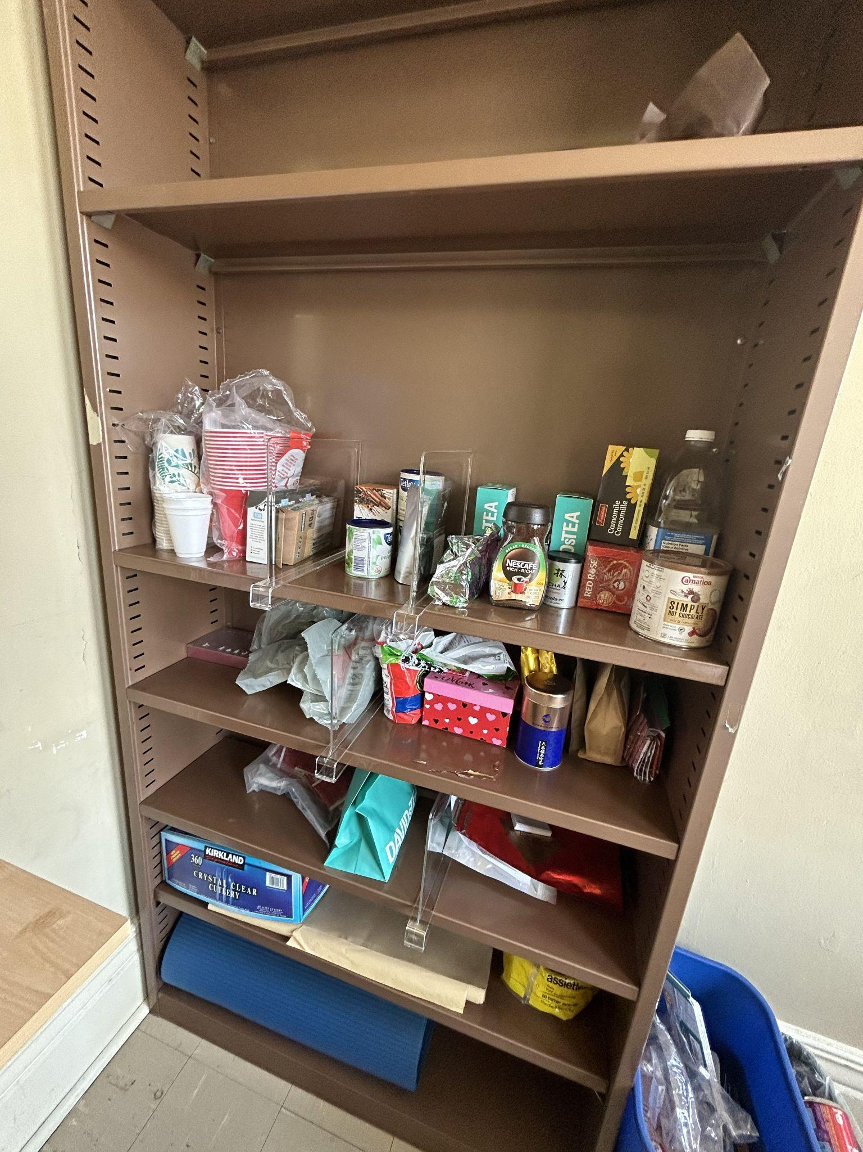
To continue measuring our success, we implemented our recommended design into room 418
Margaret Chen
Notes:
Process of implementing the design
Show how we reorganized to implement our design
Show the math that we did (create two online drawings)
How much floor space we were able to maximize
rocess of implementing the design
Show how we reorganized to implement our design
Show the math that we did (create two online drawings)
How much floor space we were able to maximize

Slide 11
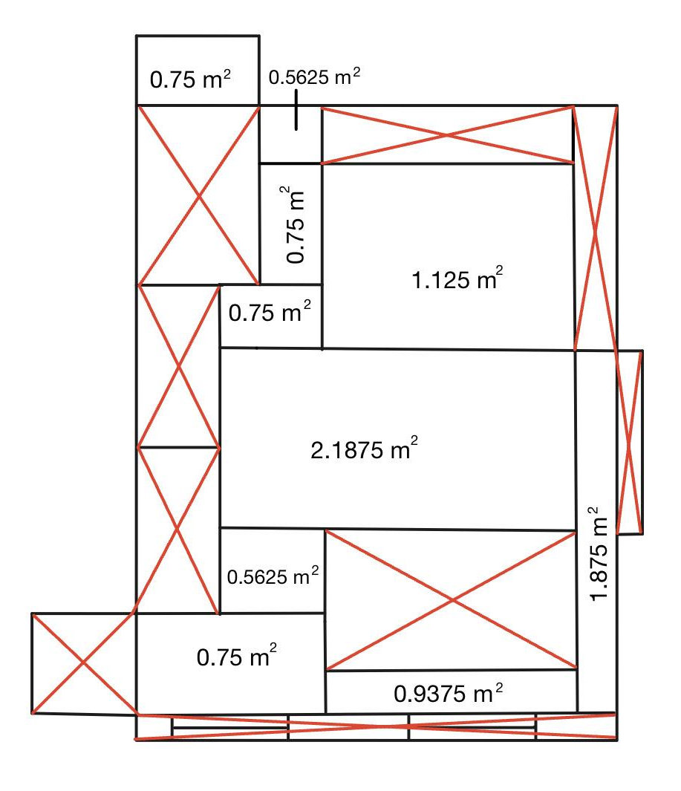
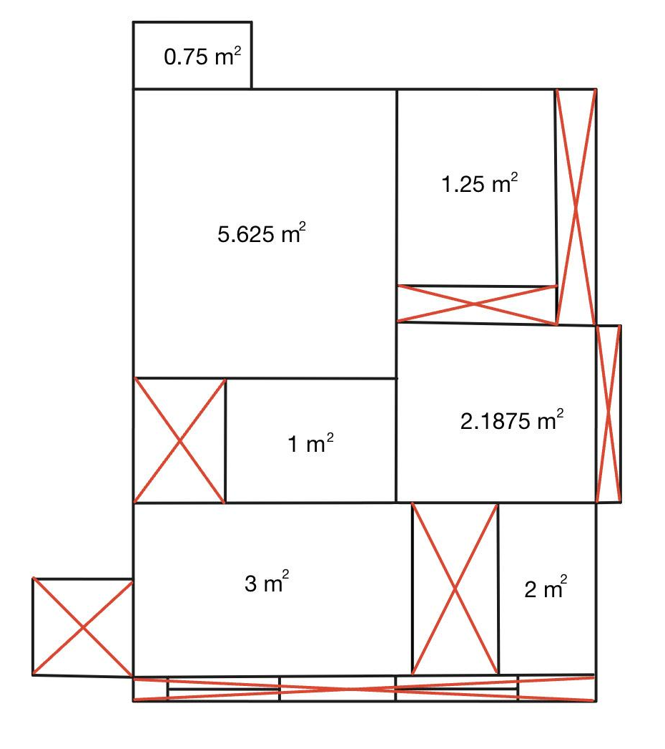
From the implementation, we were able to provide the clubs with an increase of floor space
Margaret Chen
Walkable Floor Area Before Redesign =
10.25 m²
Walkable Floor Area After Redesign =
15.8125 m²
54%
Increase in walkable
floor space
Notes:
Talking points:
Red area is where there is furniture, and the open white space is the walking space
Second survey was sent out - Analysis of survey
Show survey results of second survey
Outcome slide
Compare both surveys
Compare the math of measurements from before and after
Maximized floor space
Calculated additional floor space after room design implementation

Slide 12
Based on feedback from after the redesign, we can see significant improvement
Active Members
Students' Tea Party (sTEAp), Room 418
Lydia Messiha
Space Convenience and Comfortability: 9/10 rating
Storage Efficiency: 8/10 rating
Additional comments:
increased open space has enhanced liveliness.
small stools under the taller chairs is an ingenious solution
improves ability to serve guests
shelf dividers provide flexibility to configure the shelves
Concerns:
hooks on the closet door = good alternative
stops closet door from being fully closed.
Room Occupants
Notes:
Our team was able to send out an additional survey after the redesign to gain the clubs feedback. We were only able to gain feedback from the Uoft Students Tea Party club. Based on this feedback after the redesign, the Students’ tea Party club was able to add an additional 3 members to their club room (point to orange). Through the second survey we can see an increase in the rating of space convenience and comfortability from a 4.5 to to a 9/10. Our storage efficiency rating also was increased from 6 to 8/10, which aligns with the calculated value of 54% increase in floor space. The clubs are mostly happy with the redesign, expressing how the redesign has enhanced the liveliness in their club and improved their mobility. There were a few points of concern such as the hooks on the doors not allowing doors to be fully closed. We were only able to gain a response from the Uoft Students Tea Party club, but intend to review the economics clubs feedback for further revision of our design.

Slide 13
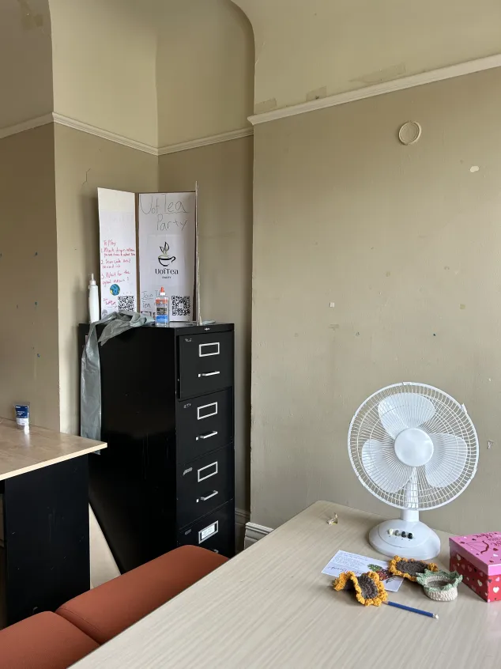
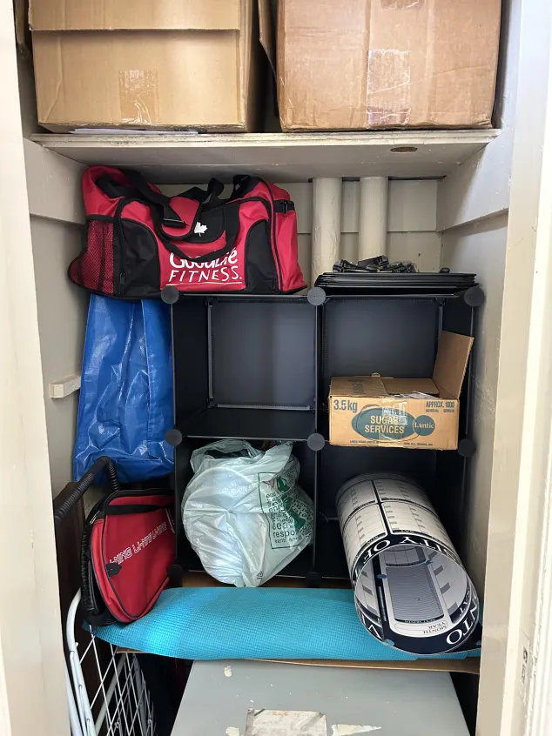
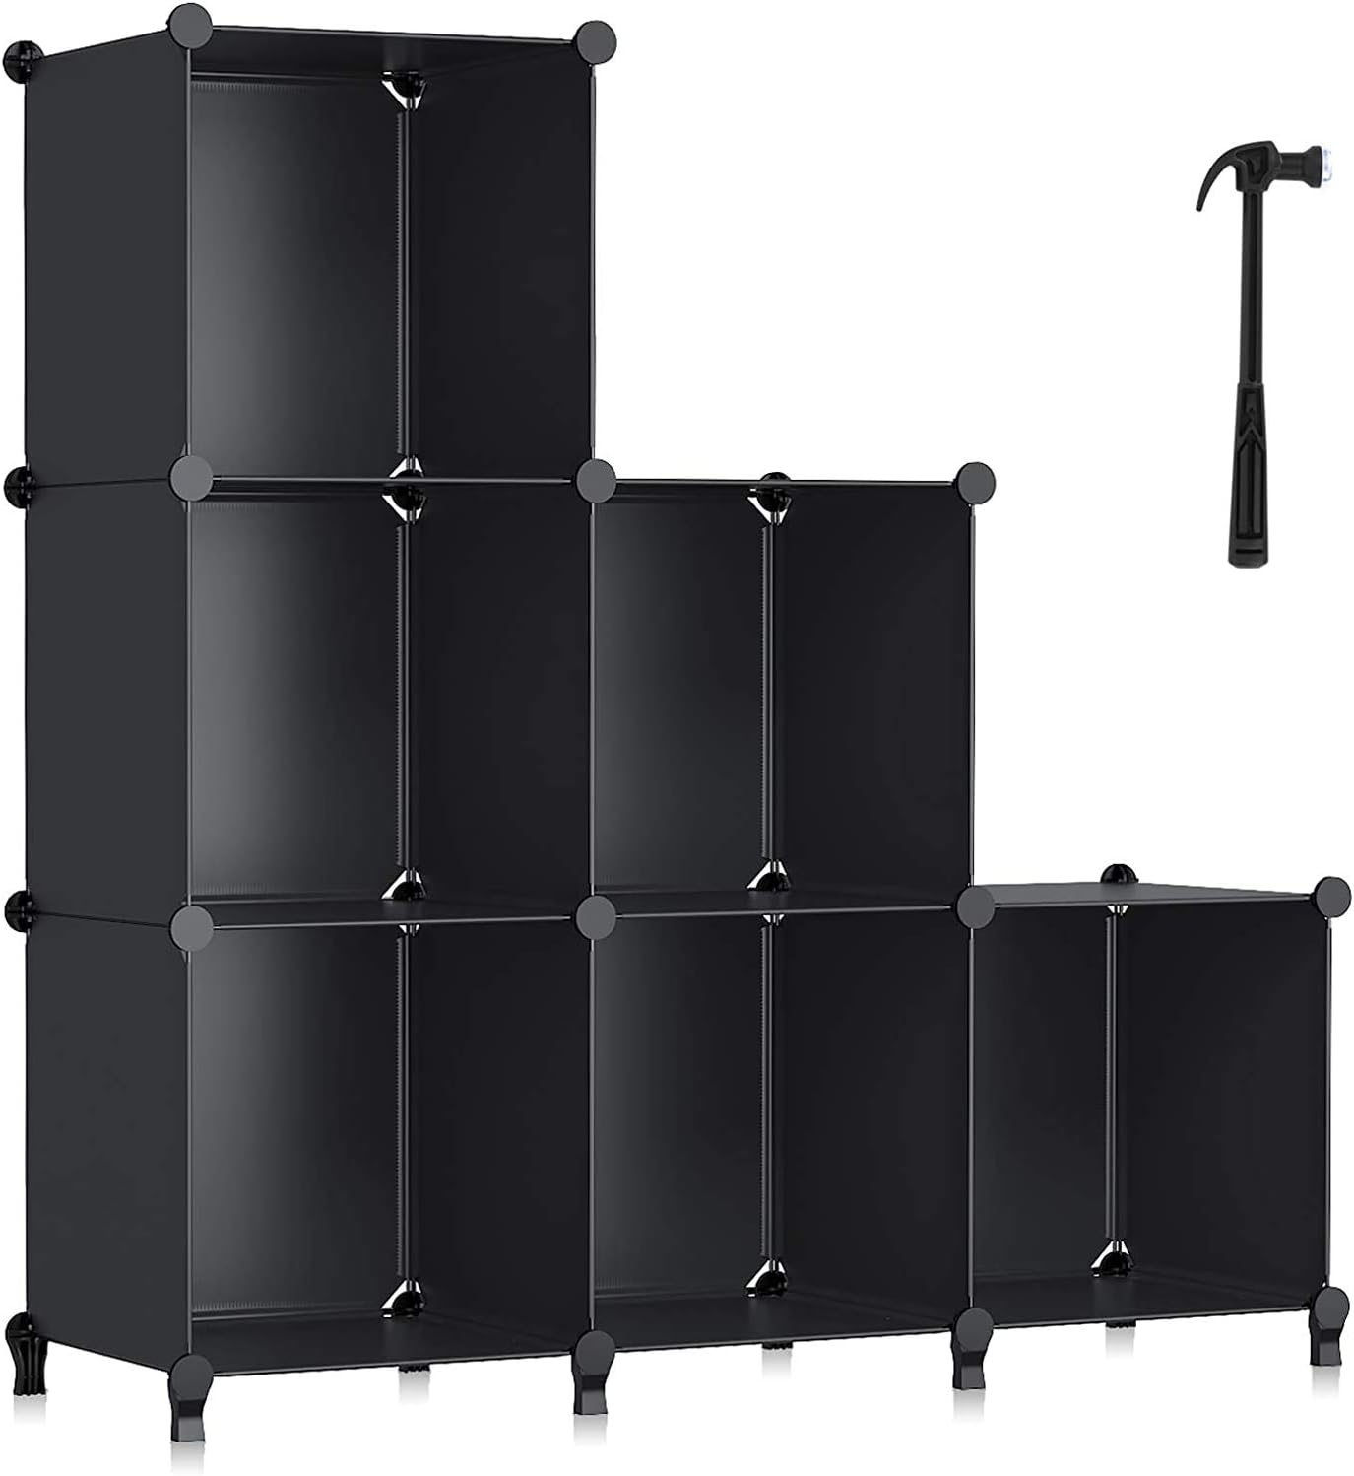
Our team’s work added value to this project through maximizing space and improving storage through our chosen design
Anjali Jammulamadaka
Providing a general layout to maximize space in rooms and hold more people
Implementing more adaptable storage and furniture and replacing older storage units (filing cabinets).

Slide 14
Our team implemented our Measures of Success given the time constraint
Anjali Jammulamadaka
Testing for One Week
Implemented Testing
Design Implemented in Only One Room
Implemented Testing vs. Ideal Testing
Testing for Four Weeks
Ideal Testing
Implementing Design in Multiple Rooms of Various Sizes

Slide 15
Given our team’s progress on this project, our next steps would be
Anjali Jammulamadaka
Continue to remodel other club rooms using our design
Improve design based on user feedback
04
01
Measure the additional space and storage gained after the redesign
Conduct Surveys with more clubs to measure club members’ satisfaction with renovation
02
03
Notes:
Evidently, our team has taken great initiative regarding the Sussex Clubhouse Space Audit project. We have been actively communicating with our client as well as club users to gain feedback on our design. We wish to continue implementing our ideas to ensure that our design is optimal and suits users needs, meeting objectives. With our team's diligent process in measuring success we wish to refine this process and hopefully follow through with a full implementation of our design.

Slide 16
References
[1] A. Ahmed et al., “TUT0114 Team 095 First Client Meeting,” February 5, 2024
[2] Ontario Building Code, O Reg. 332/12 s.3.1.17(1)
[3] "Universal Storage." Steelcase. https://www.steelcase.com/products/systems-storage/universal-storage/ (Accessed Feb. 28, 2024).
[4] "How to Report a Security Incident?" Shergroup. https://shergroup.com/post/security-incident-reporting/#:~:text=A%20security%20incident%20report%20is,like%20theft%20and%20criminal%20attacks (Accessed Feb. 28, 2024).
[5] "Contact Us." St. George Campus Safety. https://www.campussafety.utoronto.ca/contact-us (Accessed Feb. 29, 2024).
[6] Aliexpress. “Creative Paper Stool Fashion Telescopic Bench Folding Portable Space-saving Low Multi-functional Entrance Door Changing Shoe.” Accessed: March 24, 2024. [Online]. Available. https://www.aliexpress.com/item/1005003904768434.html
[7] Uline. “Metro Storage Cabinet - 2-Shelf, Walnut.” Accessed: March 24, 2024. [Online]. Available. https://www.uline.ca/Product/Detail/H-10295/Office-Storage/Metro-Storage-Cabinet-2-Shelf-Walnut
[8] Uline. “Bathroom Shelf - 12 x 5 x 4".” Accessed: March 24, 2024. [Online]. Available. https://www.uline.ca/Product/Detail/H-9521/Bathroom-Supplies/Bathroom-Shelf-12-x-5-x-4?pricode=YM650&gadtype=pla&id=H-9521&gad_source=1&gclid=CjwKCAjwnv-vBhBdEiwABCYQAz4o9ZWMX1EjfkJ-yJm7RhLrAwW7qfOHjsLXQsi1TEXu5nyfme5XvxoCqDQQAvD_BwE
[9] Wayfair. “Ahlayla Coffee Table.” Accessed: March 24, 2024. [Online]. Available. https://www.wayfair.ca/Millwood-Pines--Solid-Wood-Rustic-Coffee-Table-X211115717-L441-K~C100004650.html

Slide 17
References
[10] Uline. “4 Drawer/4 Drawer Pedestal Workbench - 60 x 30", Composite Wood Top.” Accessed: March 24, 2024. [Online]. Available. https://www.uline.ca/Product/Detail/H-2171-WOOD/Pedestal-Workbenches/4-Drawer-4-Drawer-Pedestal-Workbench-60-x-30-Composite-Wood-Top?pricode=YG086&gadtype=pla&id=H-2171-WOOD&gad_source=1&gclid=CjwKCAjwnv-vBhBdEiwABCYQA4kxIXQsR2gQFT07UinnBC-FX97CbvLIfJA3SHv6VhGURAR67jWtDBoCgK8QAvD_BwE
[11] The Furniture Depot. “Mariana Storage Ottoman.” Accessed: March 24, 2024. [Online]. Available: https://furnituredepot.ca/products/mariana-storage-ottoman
[12] Oak and Sofa Liquidators. “Homelegance Lift Top Coffee Table With Faux Marble Top.” Accessed: March 24, 2024. [Online]. Available. https://oakandsofaliquidators.com/products/lift-top-coffee-table-with-faux-marble-top_hm7916-30
[13] Bouclair. “Water Hyacinth Basket.” Accessed: March 24, 2024. [Online]. Available. https://www.bouclair.com/en/our-best-price/bed-and-bath/water-hyacinth-basket-9402490.html
https://ayerssaintgross.com/work/space-analytics/space-assessment-and-analysis/
[14] H.-M. Ji, X.-N. Liu, and X.-W. Li, “Study on the fracture toughness of softwood and hardwood estimated by boundary effect model,” Materials (Basel, Switzerland), https://www.ncbi.nlm.nih.gov/pmc/articles/PMC9182387/ (accessed Apr. 14, 2024).
[15] “What are the best practices for conducting a space audit and identifying security risks?” LinkedIn. Accessed: March 24, 2024. [Online] Available: https://www.linkedin.com/advice/0/what-best-practices-conducting-space-audit-identifying#:~:text=A%20space%20audit%20is%20a,as%20its%20strengths%20and%20weaknesses.

Slide 18
APPENDIX A. PRICE CALCULATIONS
Design 1: The average shrinkable bench costs $82.28 [1] and will add up to $575.96. Approximate sized cabinets cost $490 [2] and will add up to $4410. Wall-placed shelves add up to $213 [3]. Average office tables range from $500-1000 [4]
Design 2: Tables with drawers range from $110-$1332 [5] which total to $220-$2664. Small Ottoman seats cost $82 [6] that total to $492. Approximate sized cabinets cost $490 [2] that total to $2450
Design 3: Small Ottoman seats cost $82 [6] that total to $984. Extendable tables with storage have an average price of $420 [7] which total to $840. Average baskets that can be hung cost $20 [8] which total $360.

Slide 19
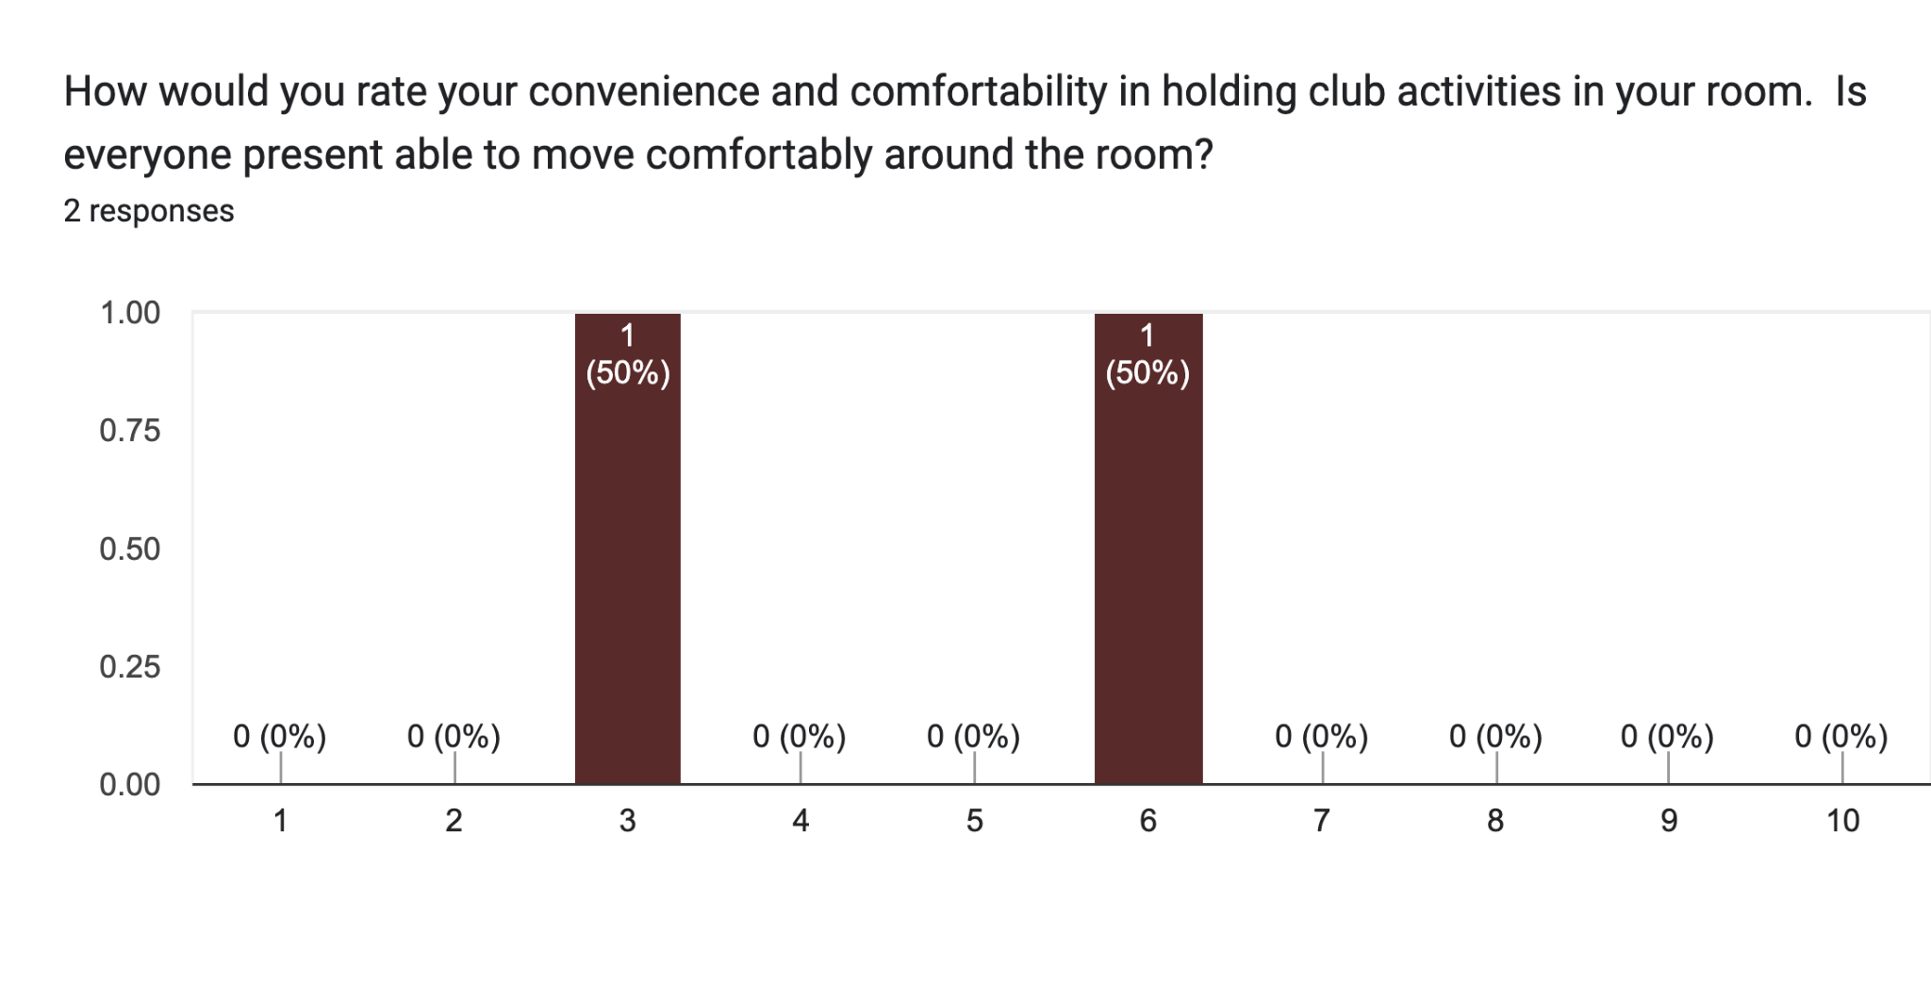
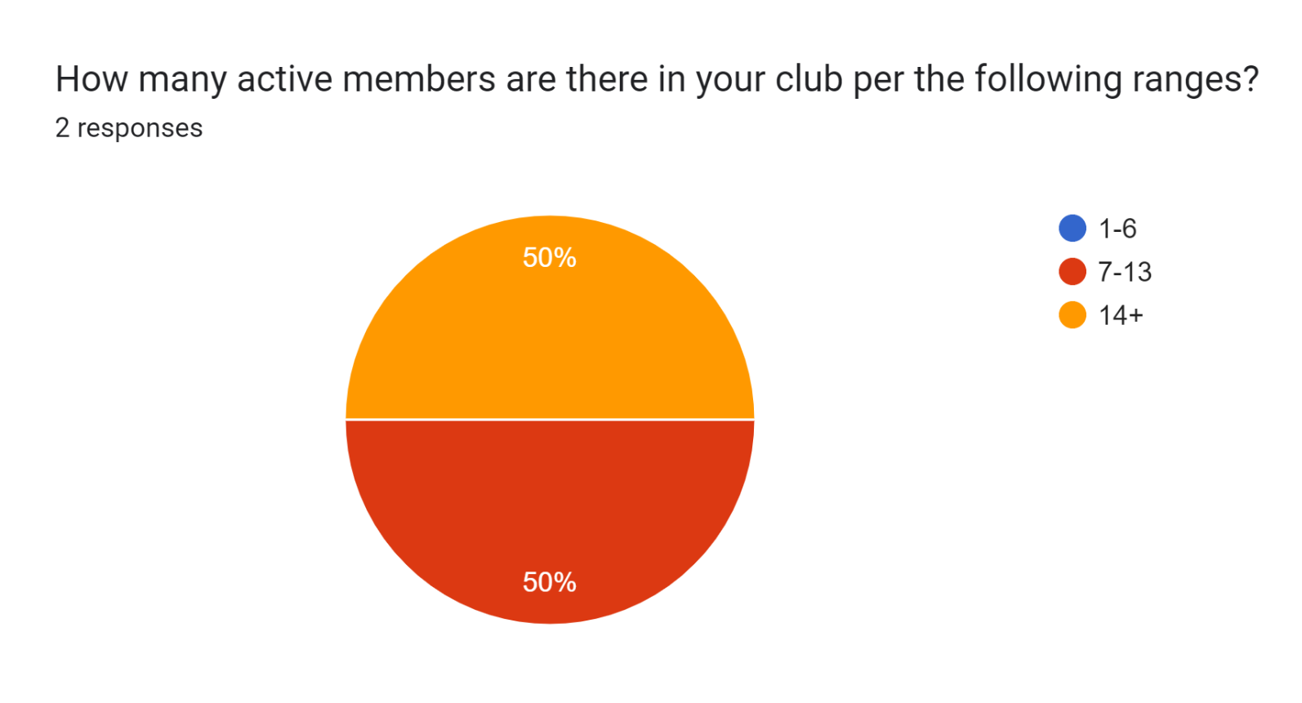
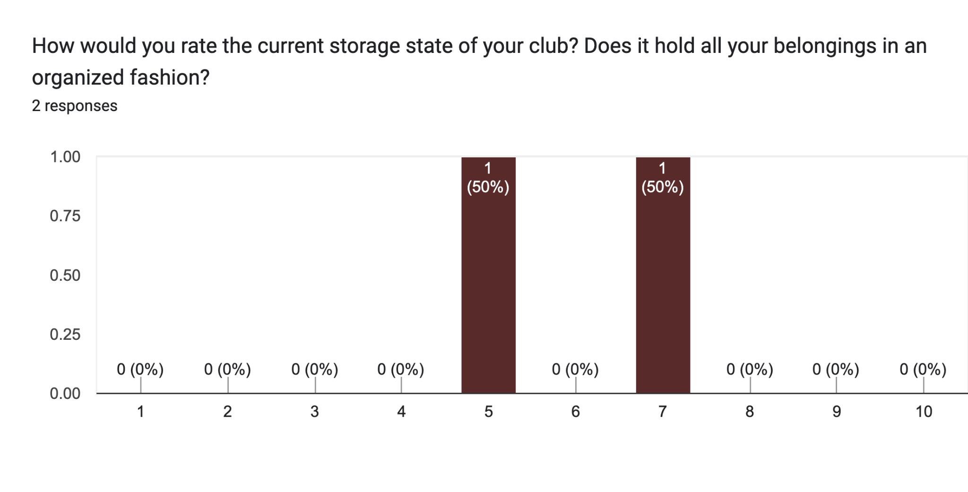
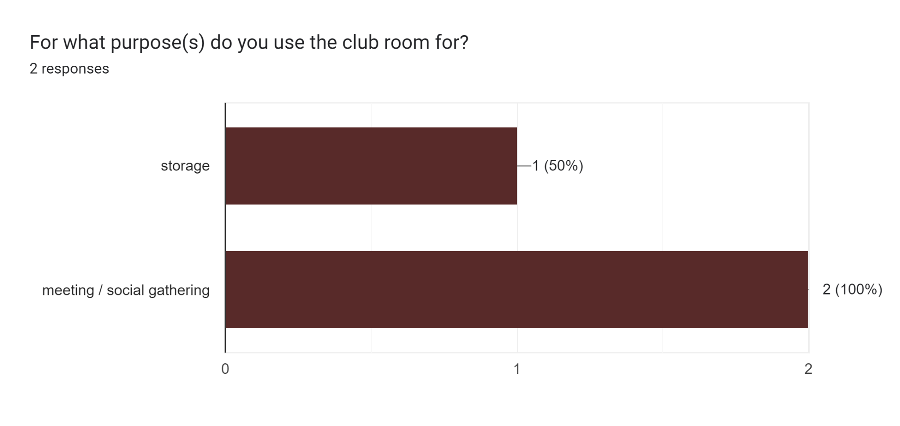
APPENDIX B. Pre-Design Responses

Slide 20
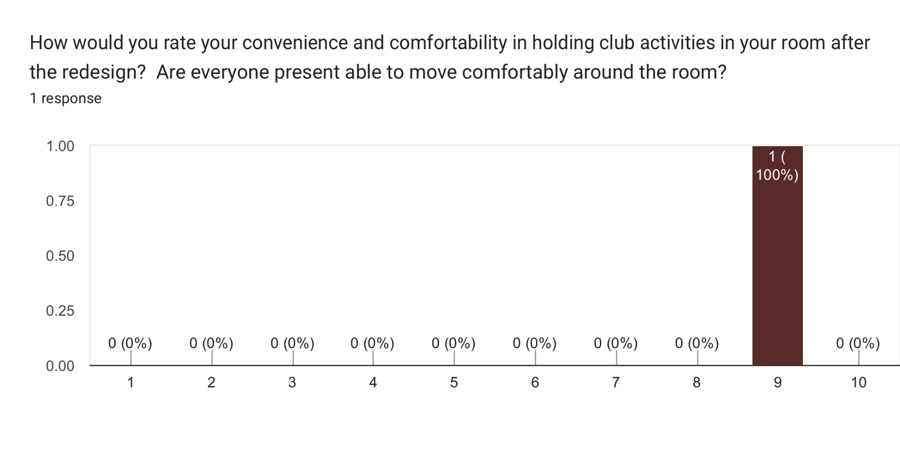
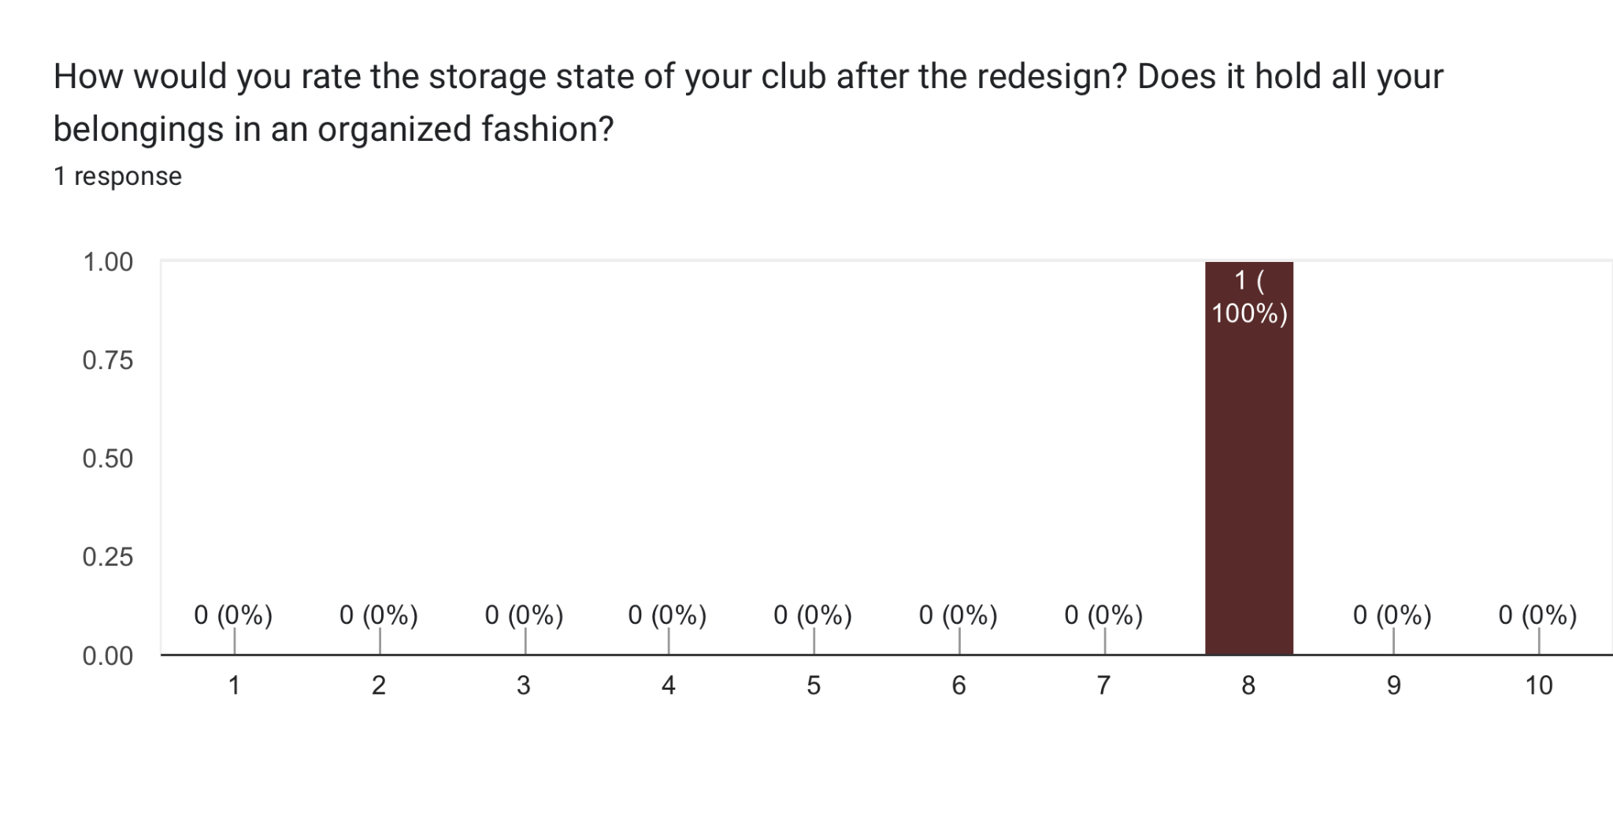
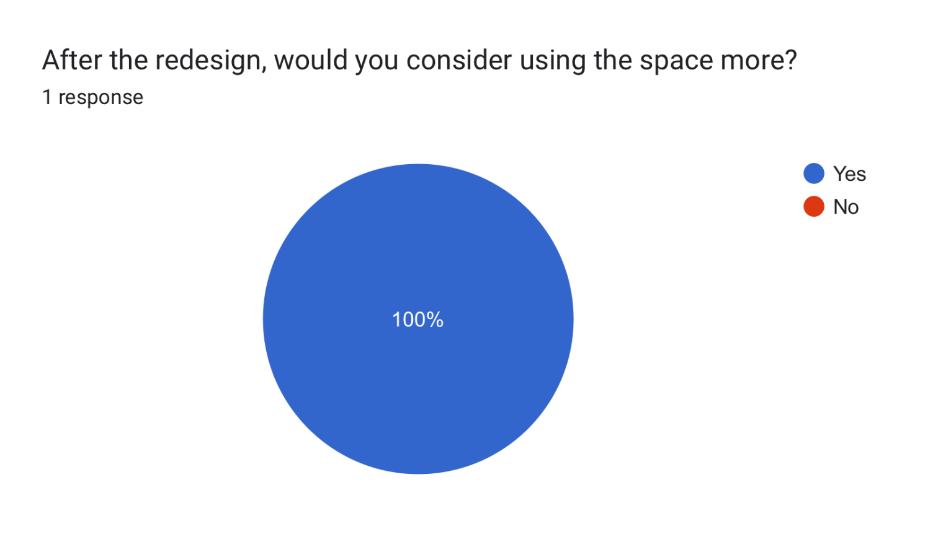
APPENDIX C. Post-Design Responses

